Slide 1
Project Milestone 2 TO-BE
Upgraded Common Application
Group 1: Grad Gurus
Ashritha Shetthalli Diwakar
Michael Rogowski
Temilade Afolabi
Matthew Valdez
Yanyun Bi

Slide 2
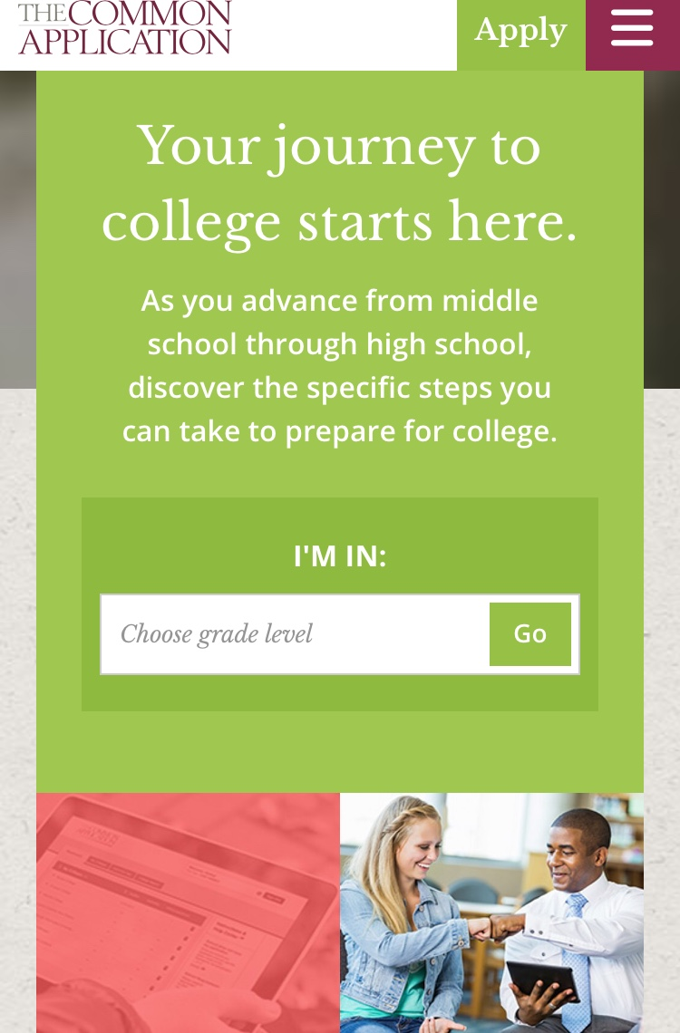
Introduction: Common App
The Common Application (informally known as the Common App) is an undergraduate college admission application that applicants may use to apply to any of more than 700 member colleges and universities in 49 states and the District of Columbia, as well as in Canada, China, and many European countries. Main purpose of Common App is to provide single application to students who can apply to multiple universities simultaneously.

Slide 3
Introduction- Identify the “Work System”
Problems | Recommendations
Not applicable for graduate applications | Add new function for graduate student applications
Only allows self-reporting of test scores | Build the connection with test center to get score
Limited to certain geographical locations and member institutes | Add member school in new country and city
No option to recall after submission | Give the permission to make some changes

Slide 4
Details
Alter’s Work System Method (WSM)
– 3 main steps:
•System and Opportunity (SO)
– Identify system | identify current issues
•Analysis and Possibilities (AP)
– Convert issues -> possibilities of improvement
•Recommendation and Justification (RJ)
– Identify/justify our recommendations
– 3 levels of detail:
•Level 2
– analysis through questions specific to each step
– Beneficial as checklist to organize own analysis

Slide 5
Details (cont’d)
AP Level 2 aims to create a balanced view of the work system & its possible improvements
AP1: “Who are the customers and what are their concerns?”
AP5: How might better information or knowledge help?
RJ Level 2 aims to identify inconsistencies and pitfalls w/recommendations
RJ1: What are the recommended changes to the work system?
RJ5: What new problems or costs might be caused by the recommended changes?

Slide 6
Define what ‘To-Be’ process should do and shouldn’t do
To-be Common App Should... | Shouldn’t...
Help students both at the undergraduate and graduate levels, local toUS and international track and manage their admission application process. | Be restricted to just undergraduate applications .
Provide verified standardized test scores securely and directly from administering boards. | Allow editing of test scores as provided and verified by ETS or college Board (non editable fields)
Considerate in making provisions for international students applying to school abroad especially the US. (E.g use of digital uploading of documents rather than mailing to individual schools and providing as much detail about each school to be sufficient to make decisions without physically visiting) | Be heavily reliant on steps requiring, calling -in, mailing or physically visiting schools (which may be impossible, difficult or really expensive for international students)

Slide 7
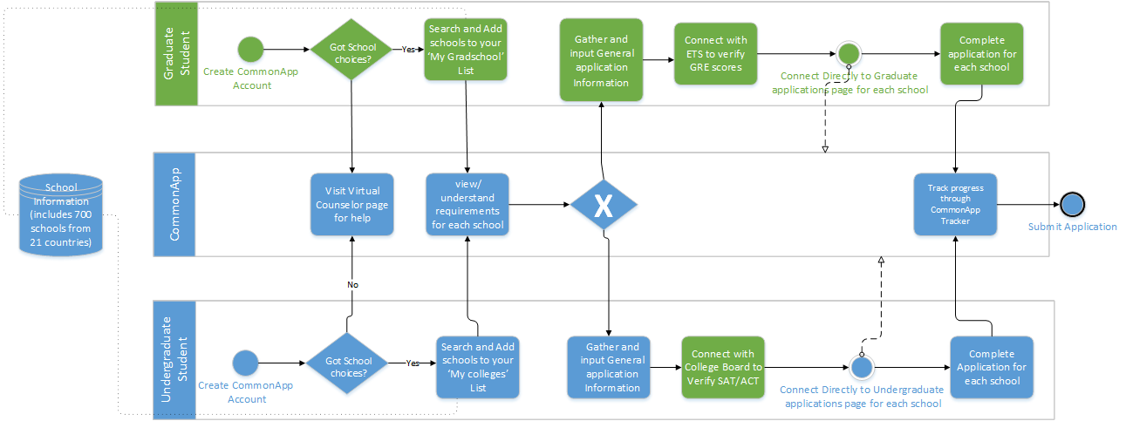
To-Be

Slide 8
Work System Snapshot
Customers | Products & Services | Processes and activities
Refers to the people using or products and services of the work system. High School Seniors applying to colleges College graduates applying to grad school. | All outputs of the commonApp that directly contribute to students being able to achieve seamless application A platform to manage college applications with interface to 700 schools across the globe. Expert Virtual Counselor on all things college. Application dictionary to understand terminology on applications | All steps involved in production of final products and services Creating a personal common app account Adding schools to dashboards Verifying standardized Test scores Interfacing with applications for different schools and completing them Getting expert college selection advice from the virtual counselor
Participants | Information | Technology
People and machines that perform the work Common app (Platform and administrators) Virtual Advisor experts Students using common App ETS/College Board (Test Verification) | Information used and created as participants do their work List of schools partnered with commonApp Account information/ contact information of commonApp users. Student information for completing application. | Tools used to bring provide or use the products and services of the work system. Desk/Laptop Smart phone for companion mobile app Databases to store list of partner schools, deadline info, and other requirements for all 700 schools Secure interface to redirect students to schools application pages

Slide 9
Means used to bridge the “capability gap”
The major capability gaps between IT and Business strategy are filled by following means;
•Improved App Design - Prioritizing User Experience Design to provide an App which has high reliability , performance quality and customer satisfaction..
•Software update and external software acquisition – Improved software features to allow Graduate student application, Connection to testing agencies (ETS,PTE,SAT), Incorporate more participating schools (not just member schools) and finally render permission to recall and edit application after submission.
•Better understanding of organization (people, Business and Technology) – Understand user expectations with the help of surveys and feedback , continuous follow ups and customer support.
mate of wh will cost

Slide 10
Estimate of what “Bridging the gap” will cost
•Cost Analysis for bridging the gap in terms of;
•Time – Assuming that the new version covers 3 to 4 major updates carried out in Agile methodology involving 1 release consisting of 4 sprints each of 2 weeks with enough time to plan, design, develop and test (SIT,UAT, regression); it would take two month of time costing anywhere between 0.8 – 1.0 million USD
•Resources and Efforts –Assuming a team of four people working on the updated version, an average cost inclusive of cross training, new resource recruitment, travel and food , commuters benefits, recreational expenses and salary compensation cost anywhere between 64,000$ - 70,000$ USD considering a yearly package of employee as 90,000$ USD
•Technology – Assuming minimal cost spent on new equipments, considering cost for retaining the old ones with expenses covered for operation and maintenance, database management, advertisement and also considering expenses of new software acquisition and installation; the total cost ranges anywhere between 1.3 – 1.5 million USD .

Slide 11
Risks and Politics
•Communication and Coordination
•Finding and obtaining people with the necessary skills and knowledge to build a Graduate application that is International student friendly
•All the involved parties agreeing on the application’s necessities
•Convincing institutions to accept the application, just like so many have for Undergraduate admissions
•Cost of Expansion
•Relationship with the Government (Bureaucracy)
•Undocumented/Illegal Immigrant Students

Slide 12
Risk | Impact | Likelihood of Occurrence | Degree of Impact | Action Trigger | Responsibility | Response Plan
Government (Bureaucratic) issue(s) | Falling behind schedule | M | M | Taking more than planned to fulfill a Government related problem | Ashritha | Move on while waiting and work on another Government task
Project scope change(s) | Falling behind schedule and spending extra money | L | H | Client asks for more features or original features take more time to complete | Michael R. | Deny request or modify schedule
Insufficient worker(s) | Gradually falling behind schedule | L | L | Worker(s) not meeting requirements | Yanyun | Talk to or replace worker(s) based on impact
Technical issue(s) | Falling behind schedule and possibly spending more money | L | M | It takes over 2 or 3 hours to resolve any technical problem(s) | Temilade | Call technical support or have an additional worker fix problem(s)
Phone call(s) or email(s) not returned promptly/Communication issue(s) | Wasting time/ falling behind schedule | M | M | Have not heard back from individual(s) in 3 or 4 hours | Matthew | Contact individual(s) again/contact someone who is close to the individual(s)

